Slide 1
Adaptation responses to increasing drought frequency
David Adamson & Adam Loch – FEEM 13th June 2016

Slide 2
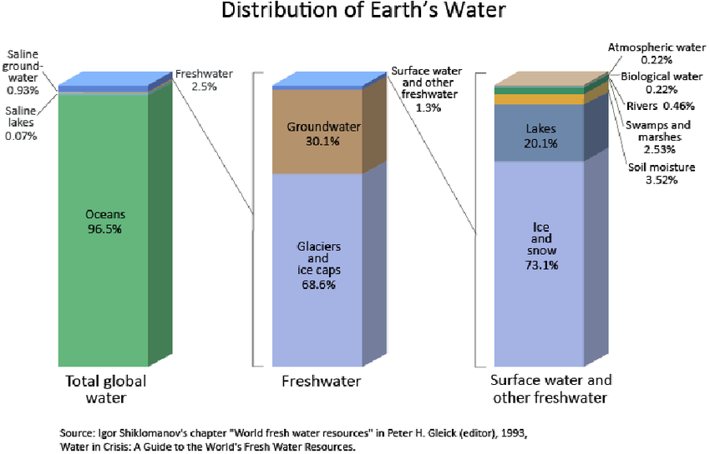

Slide 3
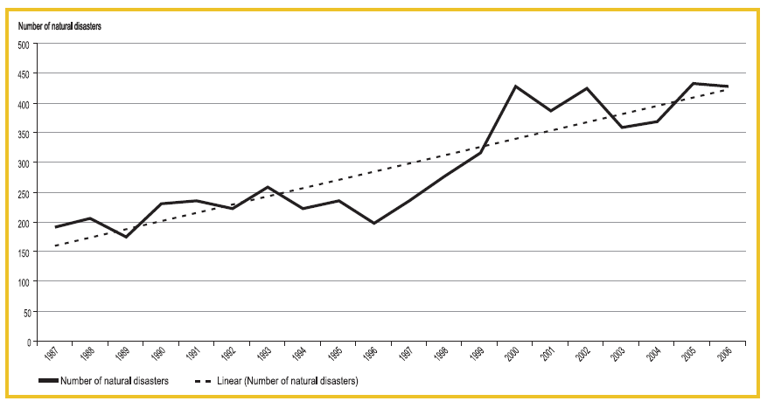
Source: Hoyois, Below, Scheuren and Guha-Sapir (2007).
The trend in natural disasters appears to be upwards

Slide 4
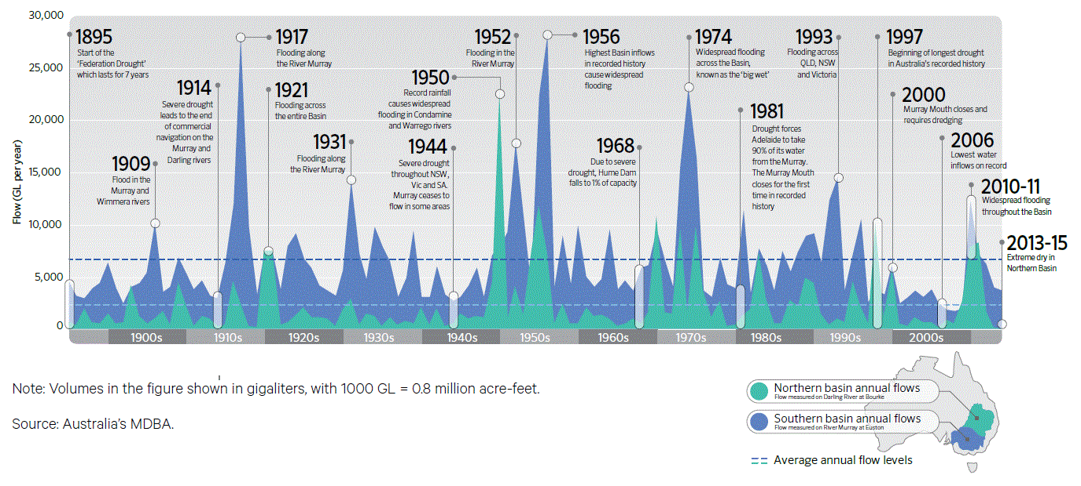
Millennium drought

Slide 5
So, how do MDB farmers adapt to drought?
Question:

Slide 6
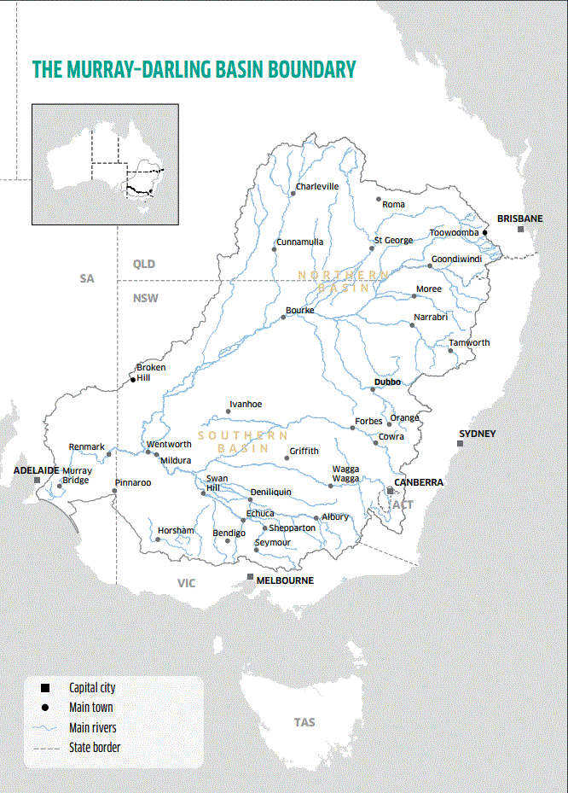
The Murray Darling Basin (MDB)
1,000,000 km²
14% of Australia (size of Spain & France)
80% of basin is agriculture
60% of Australia’s irrigation with 40% of Australia’s farmers
“Food Bowl” of Australia
Population 2,000,000; supports 20 million
5 jurisdictions
Significant environmental values
Australia’s three longest rivers
Home to 34 major Indigenous groups

Slide 7
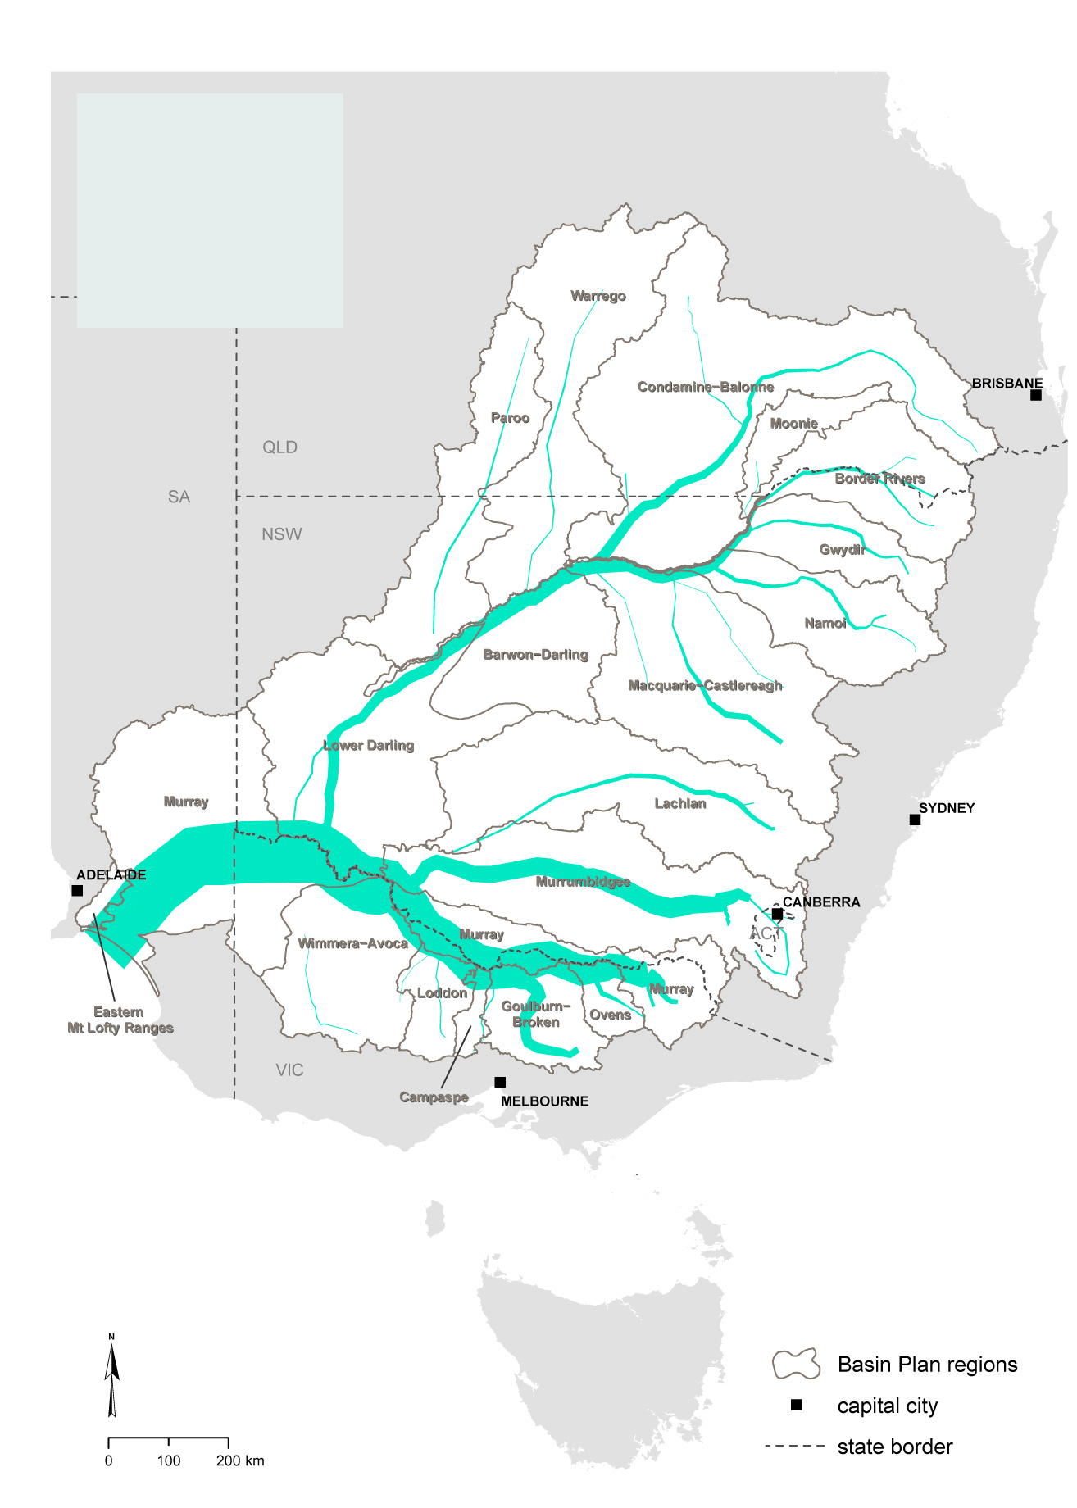
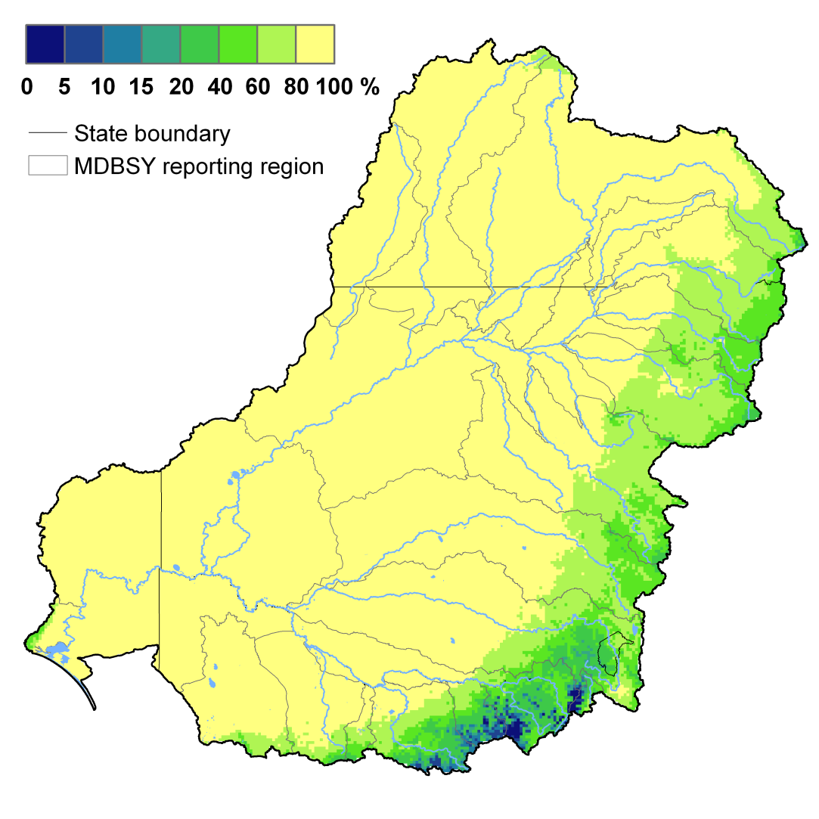
Hydrological complexity of the Basin
Basin Flow Generation
Source: MDBA
7
Notes:
7
22/09/2010
BASIN-PLAN-IN-CONFIDENCE

Slide 8
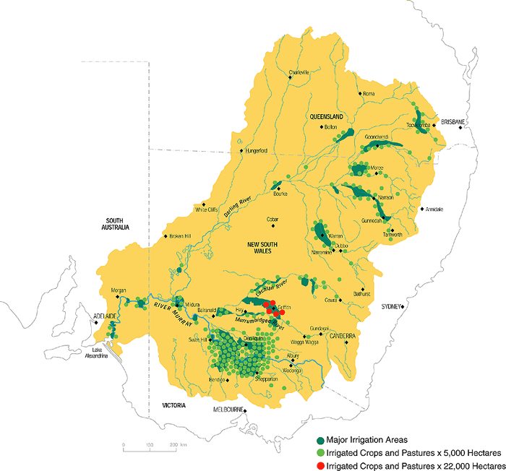

Slide 9
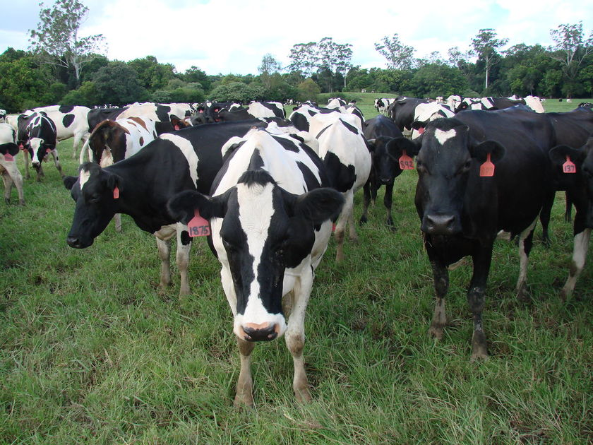
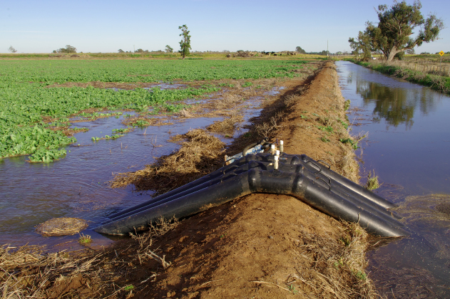
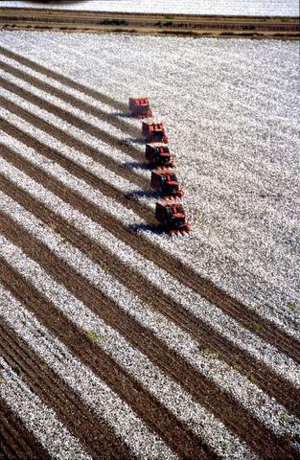
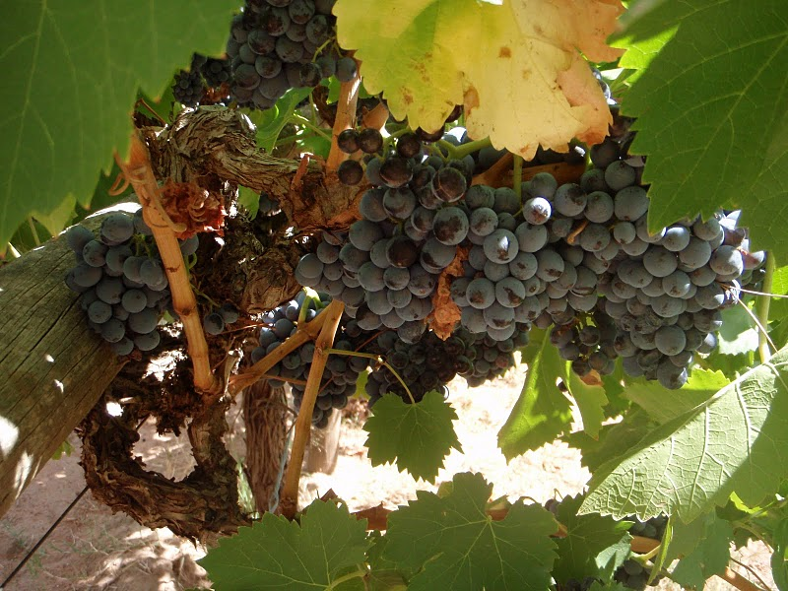
Irrigated Farm Differences across the MDB
VICTORIA
Small irrigated farms, medium water entitlements (low and high security)
Mainly permanent pasture (dairy) or annual fodder cropping
NSW
annual croppers (cotton, rice)
have larger farm sizes
have much larger water entitlements (mainly general security)
Some horticulture
SA
Permanent plantings (horticulture)
Small farms, small water entitlements (but high security)

Slide 10
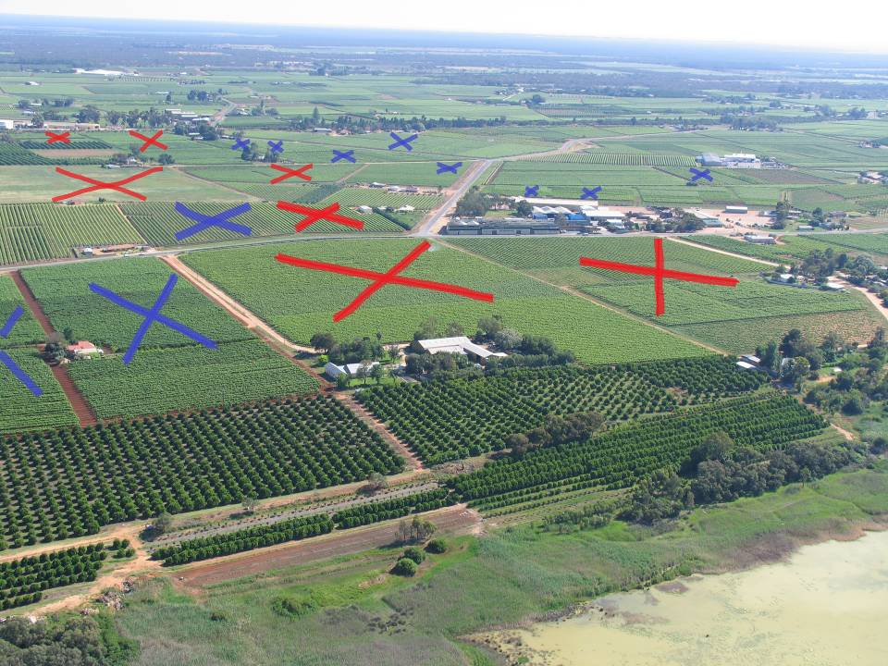
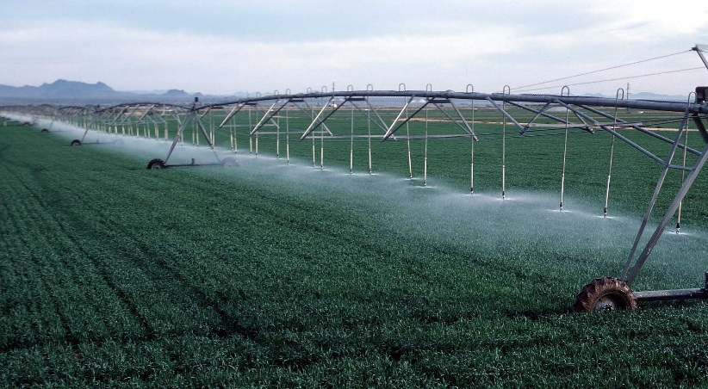
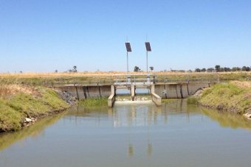
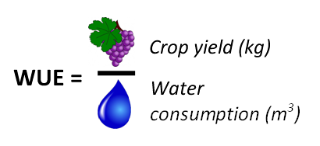
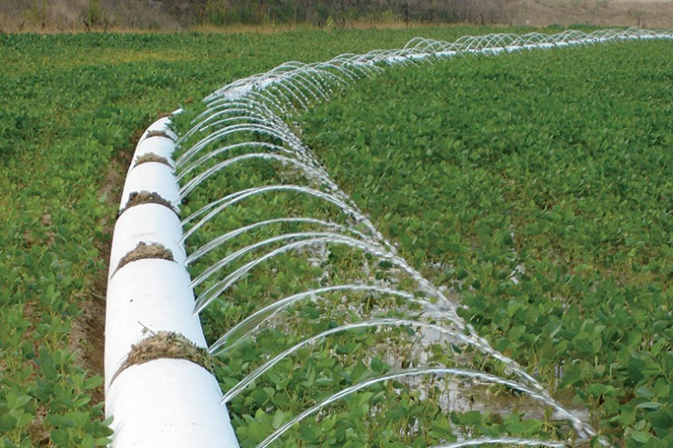
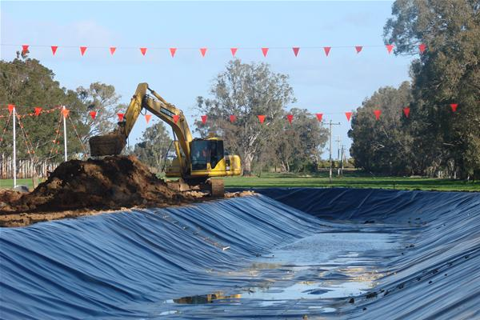
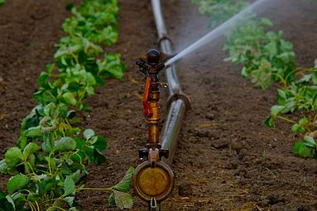
Focus on efficiency (engineering) solutions
On-farm
Off-farm

Slide 12
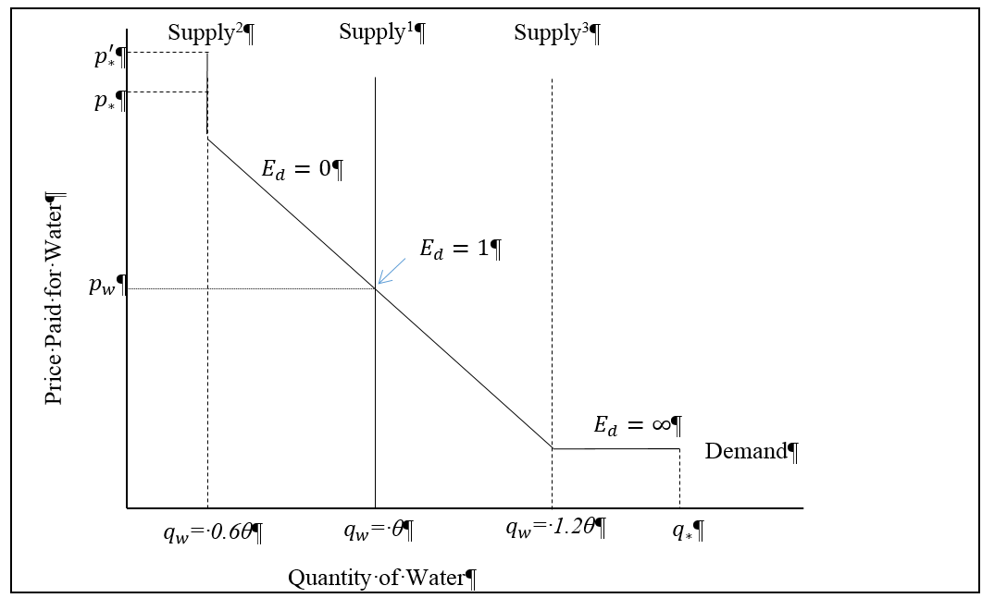

Slide 13
State contingent analysis (SCA)
We will explain how and why farmers respond differently to these signals
Section 2:

Slide 14
Decision making under uncertainty
Decision making models are the cornerstone of risk and uncertainty
Traditionally involves stochastic representation of uncertain variables and parameters
Helps illustrate the inherent variability in natural systems
BUT … Just and Pope (2003) find this provides little practical policy benefit
In response, suggest state-contingent analysis (SCA)

Slide 15
State Contingent Analysis (SCA)
Foundations are derived from Arrow (1953) and Debru (1959) work on state-space:
Nature = provides a complete description of the state-space of uncertainty $\left(S ε Ω\right)$
possible states (s) are exhaustive, mutually exclusive, and real
Chambers & Quiggin(2000) expanded on this
dual optimisation
Decision maker has no ability to control what state occurs
Each $s$ has unique management response, yields, prices, inputs and outputs
Provides a mechanism for dealing with discontinuous functions (non-convexity)
Once a state is revelled all uncertainty disappears allowing for traditional approaches to deal with risk to be used
Separates the environmental signal from the management action

Slide 16
Stochastic Water Supply

Slide 17
Water supply and allocation problem
Variability in rainfall necessitated the need for a portfolio of water rights with declining reliability of supply.
High Security
General Security
Supplementary Security
The allocation of water to rights is made throughout the season.

Slide 18
Farmer Water Supply
Total water supply in a given state $\left({TW}_{s}\right)$ is the sum of announced supply $\left({AS}_{s,n}\right)$ toward all water entitlements over a given number (n) of allocation announcements:
${TW}_{S}= \sum_{i=1}^{n}{{AS}_{s,n}}$

Slide 19
Where AS is
is the product of the water entitlement portfolio E (matrix with dimensions $\left[E ×1\right])$ and the reliability of those entitlements ER with dimensions$\left[E ×S×n\right]:$
${AS}_{s,n}=E ×{ER}_{s,n}$

Slide 20
Crop Requirements
Crop water requirements by state (${WR}_{s})$ are the sum of maintenance water $\left({MW}_{s}\right)$ required to keep a crop alive, and productive water $\left({PW}_{s}\right)$ required to generate a commercial yield:
${WR}_{s}= \left({MW}_{s} +{ PW}_{s}\right)$

Slide 21
Decision makers response to a drought
if ${TW}_{s}<{MW}_{s}$ the crop dies.
In our game there are two announcement periods$\left(n=2\right)$ and a commodity can survive without water or yield loss until $\left(n=2\right)$ is revealed.
Illustrate differences between perennial and annual crop producers in a two-period game between the producer and nature within the state space.

Slide 22
Overview of the game
(n = 1) $$A_{s}≥MW$$
(n = 2) $$A_{s}≥MW$$
Action
Action
Yes
Cost 0
Yes
No
Do nothing
Yes
No
Buy water (part)
No
Buy water (all)
Yes

Slide 23
Perennial Producer
At $\left(n=1\right)$, if ${ AS}_{s,1}<{MW}_{s}$ a producer has two options:
Wait until ${AS}_{s,2}$ is revealed betting that it will satisfice${MW}_{s}$
Or enter the market and purchase water

Slide 24
Perennial Producer: Decision Wait
Wait until ${AS}_{s,2}$ is revealed
As the maintenance supply gap $MG= {MW}_{s}−{AS}_{s,1} → {AS}_{s,1}−{MW}_{s}$ the producer becomes the ultimate risk-taker, betting that ${AS}_{s,2}= {MW}_{s}−{AS}_{s,1}$.
If ${AS}_{s,2} < {MW}_{s}−{AS}_{s,1}$and the producer wishes to keep the crop alive:
Water price $→$ choke price $P_{∗}$ or $P_{∗}^{′}$ per megalitre
The cost of this strategy will be $MG×P_{∗} or P_{∗}^{′}$.

Slide 25
Perennial Producer: Decision Wait
But, if water is not available:
reduce their irrigated area until${ TW}_{s,n}={WR}_{s}$
In this case the per Ha loses are
capital invested and,
opportunity costs associated with bringing forward investments.

Slide 26
Perennial Producer: Decision Buy All
at $\left(n=1\right)$, purchase water $\left({WT}_{s,1}\right)$ to offset $MG$.
As ${WT}_{s,1 }→MG$, the producer is betting that ${AS}_{s,2}→0$; they can be described as the ultimate risk-averse producer with perfect capital preservation objectives.

Slide 27
Perennial Producer: Decision Buy All
at $\left(n=1\right)$ if the majority of producers believe that the future state will be $s1$ then the price of water $≅p_{w}$.
At $\left(n=2\right)$, should ${WT}_{1}+{TW}_{s}>{WR}_{s}$, the producer can:
bring idle resources into production;
Sell surplus water on the market;
Carry the water over to use next year if they believe ${TW}_{s}<{WR}_{s}$;
or deliver third-party benefits (e.g. environmental or return flow positive externalities).

Slide 28
Perennial Producer: Decision Buy Part
Instead, if ${WT}_{1}+{TW}_{s}<{WR}_{s}$ the producer can repeat the strategy adopted at $\left(n=1\right)$ and purchase more water $\left({WT}_{s.2}\right)$, or revert to the risk-neutral/taking strategy of maintaining capital stocks with reduced yields.
But purchases of water in $\left(n=1\right)$ reduce the total costs of purchases in $\left(n=2\right)$ by ${WT}_{1}$ * Price

Slide 29
Perennial Producer: Decision Buy Part
If no water to trade then
the area lost to production is ${WT}_{1}$ less than the decision not to buy water.
So a risk-averse producer should ensure their water entitlement portfolio
maintenance requirements in all states ${AS}_{s=2,n=2}= {MW}_{s,n}$ ; and
maximum irrigation land is constrained by ${TW}_{s=2,n=2}$.
This conforms with Rasmussen (2003), who argued
that risk-averse producers will use more inputs that risk-neutral producers, especially if that input increases output in adverse states of nature.

Slide 30
Annual Producer
For annual producers, water is a state allocable input for which ${MW}_{S}=0$
As don’t have to keep the capital stock alive

Slide 31
Annual Producer: Risk Adverse
The risk-averse annual producer will only apply water $x$ if: there is sufficient ${TW}_{s}$ at either $(n=1 or 2)$ to rationalise the use of their other inputs (land, labour, capital), and where the expected profit from consumptive production is greater than the expected returns from selling ${ AS}_{s,1} or{ AS}_{s,2}$water on the market.
The production choice sets at $(n=1 and n=2)$ are different, varieties, choices (due to delay in planting time).

Slide 32
Annual Producer: Risk Taker
If the annual producer plants at $\left(n=1\right)$, and ultimately at $\left(n=2\right)$, if ${TW}_{s}<{{MW}_{s}=0 +PW}_{s}$, they can engage in the same management choice sets as the perennial producer—
but zero risk of losing capital, or the opportunity costs of replacing capital.

Slide 33
Outcomes
(n = 1) $$A_{s}≥MW$$
(n = 2) $$A_{s}≥MW$$
Action
Action
Cost of actions
Yes
Cost = 0
Yes
Cost = 0
$$WT≥MV$$
$$\left(MV−A_{s}\right)∗P_{∗}orP_{∗}^{′}$$
No
Do nothing
$$\left(Capital loss\right)$$
$$WT=0$$
Yes
$$WT\left(MV−A_{s}\right)P_{w}$$
No
Buy water (part)
No
$$WT≥MV$$
$$WT\left(MV−A_{s}\right)P_{w}+ \\ \left(1−WT\right)\left(MV−A_{s}\right)P_{∗}$$
Buy water (all)
$$WT=0$$
$$WT\left(MV−A_{s}\right)P_{w}+ \\ \left(1−WT\right)∗\left(Capital loss\right)$$
Yes
$$\left(MV−A_{s}\right)P_{w}$$

Slide 34
The Millennium Drought: Black Swan Event
Reduction by 2/3^{rds}

Slide 35
How good was the last prior? (Inductive reasoning?)
Source: Loch (2011)

Slide 36
How good was the last prior? (Inductive reasoning?)
Source: Loch (2011)

Slide 37
How good was the last prior? (Inductive reasoning?)
Source: Loch (2011)

Slide 38
How good was the last prior? (Inductive reasoning?)
Source: Loch (2011)

Slide 39
Change in Irrigated Area (‘000 Ha)
Commodity group | 00-01 | 01-02 | 02-03 | 03-04 | 04-05 | 05-06 | 06-07 | 07-08 | 08-09 | 09-10 | 10-11
Pasture for dairy and other livestock | 760 | 707 | 551 | 669 | 703 | 717 | 446 | 365 | 272 | 393 | 375
Rice | 178 | 145 | 44 | 65 | 51 | 102 | 20 | 2 | 7 | 19 | 74
Cereals (excl. rice) | 260 | 354 | 416 | 340 | 324 | 329 | 266 | 291 | 245 | 216 | 165
Cotton | 405 | 394 | 218 | 174 | 258 | 247 | 126 | 53 | 104 | 138 | 332
Grapes | 84 | 86 | 89 | 87 | 92 | 106 | 112 | 106 | 101 | 96 | 94
Fruit (excl. grapes) | 59 | 62 | 74 | 59 | 63 | 75 | 78 | 71 | 67 | 79 | 80
Vegetables | 37 | 35 | 31 | 40 | 35 | 32 | 26 | 28 | 22 | 25 | 32
Other agriculture | 41 | 34 | 43 | 67 | 62 | 46 | 52 | 42 | 111 | 8 | 3
Total Agriculture# | 1,824 | 1,817 | 1, 466 | 1,501 | 1,588 | 1,654 | 1,101 | 958 | 929 | 976 | 1,201
Source: ABS (multiple years) Water Use on Australian Farms. # Totals may not equal the sum due to multiple cropping practices and errors in estimates

Slide 40
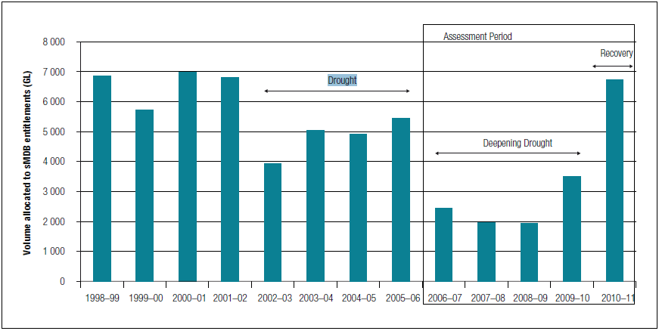
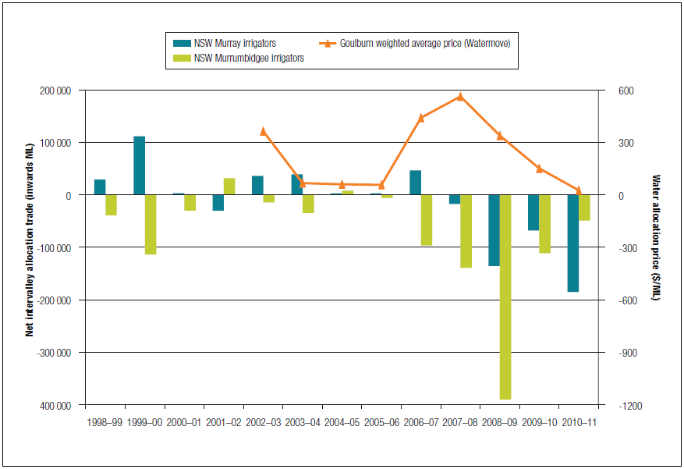
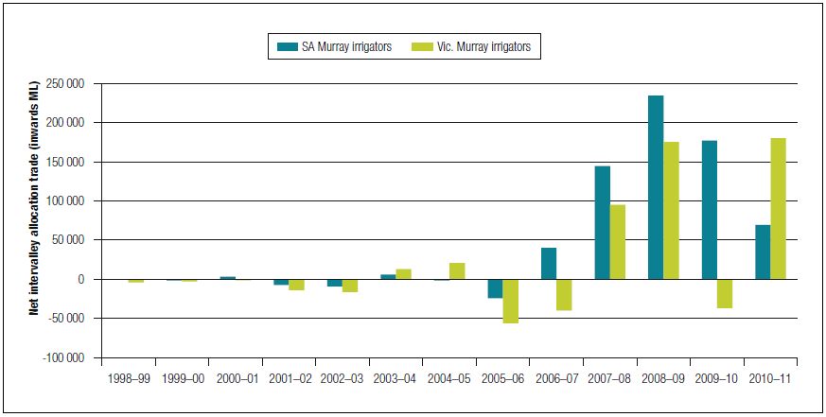
Perennials
Annuals
Source: NWC, 2012 Impact of water trading in the southern Murray-Darling Basin between 2006-07 and 2010-11, National Water Commission, Canberra.
Notes:
This is nice!

Slide 41
Discussion
Section 3:

Slide 42
Incorrect specification of risk essentially shifts producer perceptions of the reliability of their portfolio of water property rights away from q_{w}
Results in a gradual transition toward more homogenous production systems
Risk mitigation policies should encourage reallocation of water entitlements towards enhanced flexibility to deal with future unknowns
Paper provides more detail on frequency/description of states’ change reallocation responses. Time constraints prevent us doing same here.

Slide 43
Annual commodities should be recognised as a very important risk-mitigating strategy to increase the resilience of Australian agricultural production in dry states of nature
Increased drought frequencies will create:
increased future capital vulnerability;
future farm debt where positive returns diminish over time; and
increased reliance on both water entitlement and allocation transfers in a relatively more constrained market supply context.

Slide 44
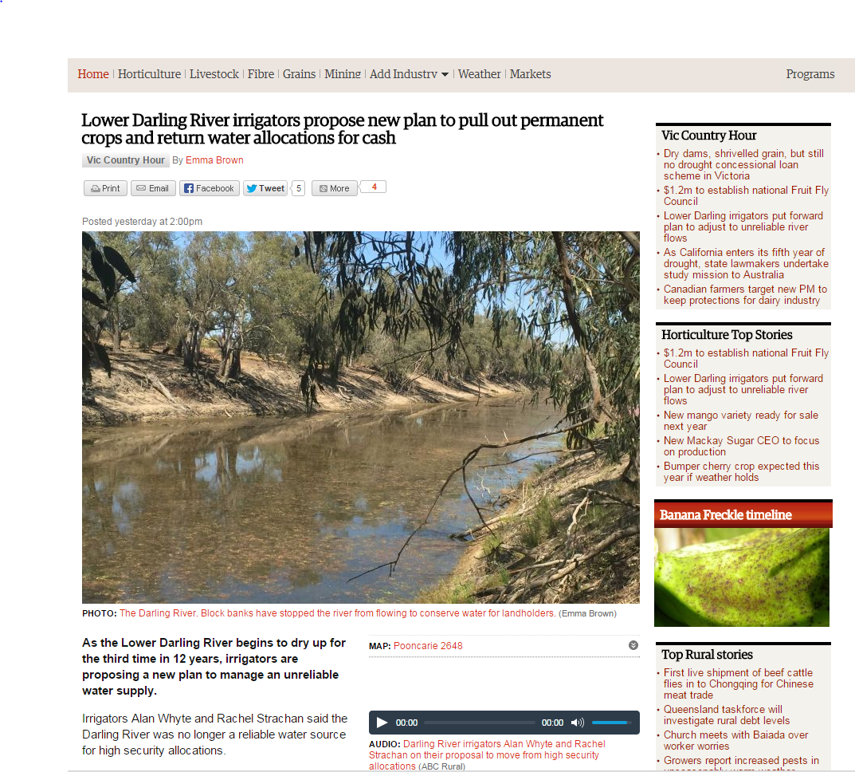
Australia already going that way?

Slide 45
Thank you
d.Adamson@uq.edu.au | adam.loch@Adelaide.edu.au

