Slide 1
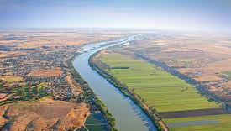
Economic instruments for water reform in Australia and Europe
David Adamson, School of Economics
UQ Water Forum, July 45-, 2016
Sustainable Water Program @ the UQ Global Change Institute

Slide 2
Research question
Water challenges are traditionally addressed with supply policies and engineering solutions. However, future benefits of this approach is limited as:
must provide an equitable share of water resources = welfare loss (economic, social & environment)
Understand the nature of bad events (droughts and floods) and past climate is not a good predictor of the future climate (i.e. future severity and frequency of bad events will and about less water
Market based solutions may provide some insights into dealing with this (about understanding the nature of D & S and realigning them)

Slide 3
How I explored the research question…
Working on Water Reform in Murray-Darling Basin (MDB) since 2004:
Murray-Darling Basin Authority (MDBA) Technical Modelling Group for the Basin Plan
PhD: reviewed the Basin Plan
Buy-back
SRWUIP
Built a model for DNRM to price water property rights
My DECRA reviews the implementation of the Basin Plan with a focus on delivering water to the environment

Slide 4
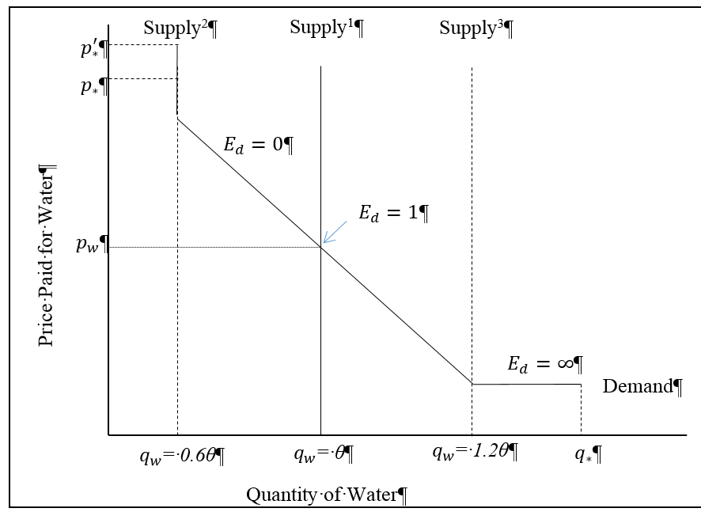
What I found…
Australia is well ahead of Europe
Property rights
Political leadership
Water trade
Buy-Back is good
Water-use efficiency bad
Subsidies
The past is a lousy predictor of the future

Slide 5
The ‘global change’ aspect of my water research
Taking Australian examples to Europe. This included delivering a policy session at EAERE Zurich 2016, 22-25 June with a group of upcoming award winning ECRs.
In the process of developing long term funding projects Europe and Australia. This is being done in collaboration with FEEM in Venice, Adelaide University, Alcaca University (Spain), Cranfield University, International Institute for applied Systems (Austria), FEEM (Italy)
Model of the Po River Basin (Spain is the next example)
Working on transaction costs of policy reform

Slide 6
Contact details: Dr David Adamson, School of Economics, UQ d.adamson@uq.edu.au
References:
Adamson, D 2015, 'Restoring the Balance: Water Reform & the Murray Darling Basin Plan', PhD thesis, The University of Queensland,
Loch, A & Adamson, D 2015, 'Drought and the rebound effect: a Murray–Darling Basin example', Natural Hazards, vol. 79, no. 3, pp. 1429-49.
Adamson, D & Loch, A 2014, 'Possible negative sustainability impacts from ‘gold-plating’ infrastructure', Agricultural Water Management, vol. 145, no. Nov, pp. 134-44.

